Slide 1


TVQA+: Spatio-Temporal Grounding for Video Question Answering
Jie Lei, Licheng Yu, Tamara L. Berg, Mohit Bansal
UNC Chapel Hill
ACL 2020
Notes:
Hello everyone, I am Jie. Today I am going to present our paper, TVQAplus, Spatio-Temporal Grounding for Video Question Answering.
My collaborators are Licheng, Tamara and Mohit, we are from UNC Chapel Hill.

Slide 2
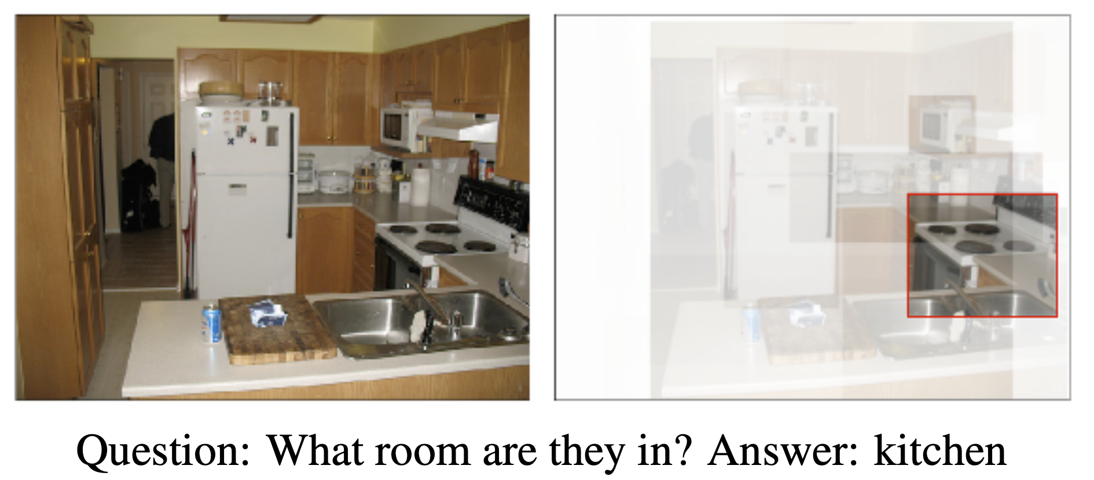
Image QA Example
ACL 2020
[Antol et al., ICCV 2015; Anderson et al., CVPR 2018]
Notes:
We have witnessed great progress in recent years on image-based visual question answering (QA) tasks.
One key to this success has been spatial attention where neural models learn to attend to relevant regions for predicting the correct answer.
In this VQA example, the model learns to automatically attends to regions that are relevant to kitchen when answering the question what room are they in.

Slide 3

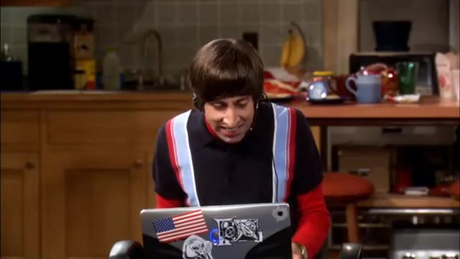
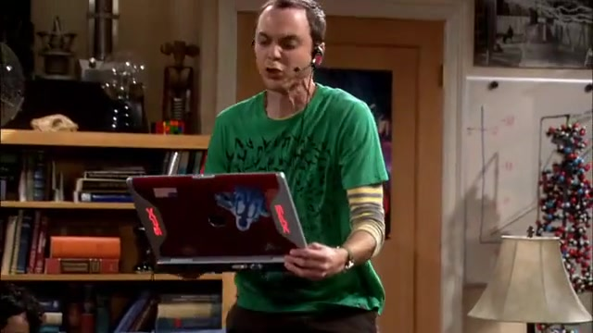
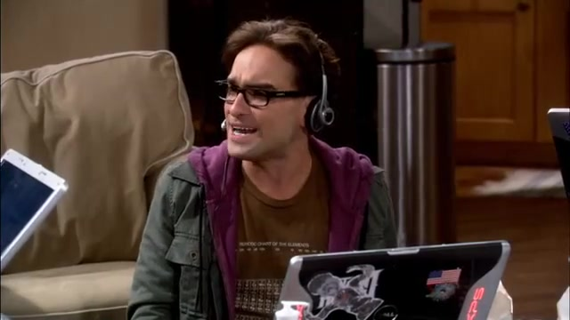
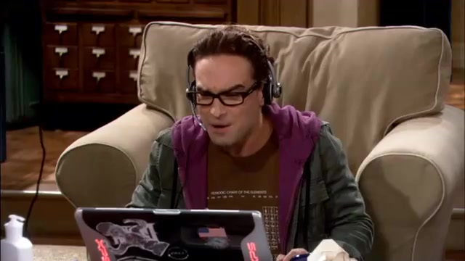
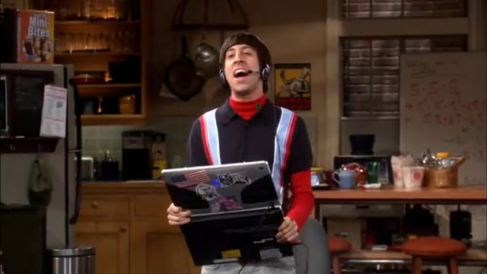
Video QA Example
00:00
01:02
00:00,562 --> 00:02,142
Raj: Oh, he's got me.
00:02,314 --> 00:10,992
Howard: Sheldon, he's got Raj. Use your sleep spell. Sheldon. Sheldon.
Sheldon: I've got the Sword of Azeroth.
00:12.600 --> 00:14.761
Leonard: Damn it, man, we're dying here..
00:00:38,308 --> 00:00:41,518
I am the sword master.
…
…
What is Sheldon holding when he is talking to Howard about sword?
0) A comic book
1) A computer
2) A sword
3) A toy train
4) A drink
ACL 2020
[Lei et al., EMNLP 2018]
Notes:
Compared to image-based QA, there has been less progress on the performance of video-based QAs.
One possible reason is that the attention techniques are harder to generalize due to the spatio and temporal nature of videos.
Moreover, due to the high cost of annotation, most existing video QA datasets only contain QA pairs, without providing labels for the key clips or regions that are needed to answer the question.
[NEXT] Recent work..

Slide 4
Video QA Example
00:00
01:02
00:00,562 --> 00:02,142
Raj: Oh, he's got me.
00:02,314 --> 00:10,992
Howard: Sheldon, he's got Raj. Use your sleep spell. Sheldon. Sheldon.
Sheldon: I've got the Sword of Azeroth.
00:12.600 --> 00:14.761
Leonard: Damn it, man, we're dying here..
00:00:38,308 --> 00:00:41,518
I am the sword master.
…
…
00:02
00:10
What is Sheldon holding when he is talking to Howard about sword?
0) A comic book
1) A computer
2) A sword
3) A toy train
4) A drink
ACL 2020
[Lei et al., EMNLP 2018]
Notes:
Recent work, TVQA provides questions annotated with key clips, but spatial region annotation is still missing.

Slide 5
TVQA+ Example
00:00
01:02
00:00,562 --> 00:02,142
Raj: Oh, he's got me.
00:02,314 --> 00:10,992
Howard: Sheldon, he's got Raj. Use your sleep spell. Sheldon. Sheldon.
Sheldon: I've got the Sword of Azeroth.
00:12.600 --> 00:14.761
Leonard: Damn it, man, we're dying here..
00:00:38,308 --> 00:00:41,518
I am the sword master.
…
…
00:02
00:10
What is Sheldon holding when he is talking to Howard about sword?
0) A comic book
1) A computer
2) A sword
3) A toy train
4) A drink
ACL 2020
Notes:
To enable this line of research, we collect new joint spatio-temporal annotations for a subset of the TVQA dataset. Where we provide frame-level bounding box annotations for the objects and people in the questions and the correct answers.

Slide 6
TVQA+ Annotation Process
Identify Visual Concepts
We use Stanford CoreNLP part-of-speech tagger to extract all nouns in the questions and correct answers, we then manually filter out frequent non-visual nouns (e.g., “time”).
ACL 2020
[Manning et al., ACL 2014]
Notes:
To obtain spatial bounding box annotations, we first identify visual concepts words in the questions and correct asnwers.
We use Stanford CoreNLP part-of-speech tagger to extract all nouns in the questions and correct answers, we then manually filter out frequent non-visual nouns (such as “time”).

Slide 7
TVQA+ Annotation Process
Identify Visual Concepts
We use Stanford CoreNLP part-of-speech tagger to extract all nouns in the questions and correct answers, we then manually filter out frequent non-visual nouns (e.g., “time”).
Question: What does Penny ask Sheldon when Sheldon is on his laptop?
Correct Answer: What is AFK?
ACL 2020
Notes:
For the question What does Penny ask Sheldon when Sheldon is on his laptop? The correct answer is what is AFK.
[Next] we first identify the nouns

Slide 8
TVQA+ Annotation Process
Identify Visual Concepts
We use Stanford CoreNLP part-of-speech tagger to extract all nouns in the questions and correct answers, we then manually filter out frequent non-visual nouns (e.g., “time”).
Question: What does Penny ask Sheldon when Sheldon is on his laptop?
Correct Answer: What is AFK?
ACL 2020
Notes:
we first identify the nouns, Penny, Sheldon, laptop, and AFK. [CLICK]
And then remove non-visual nouns such as AFK in this example.

Slide 9
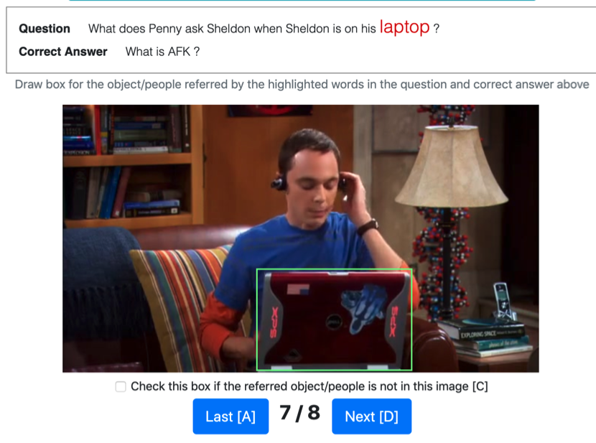
TVQA+ Annotation Process
Bounding Box Annotation
We sample 1 frame every 2 seconds inside the temporal spans of the questions and ask workers to annotate each visual concept and frame pairs.
ACL 2020
Notes:
Next, we associate the identified visual concepts with spatial bounding boxes.
Specifically, we sample 1 frame every 2 seconds inside the temporal spans of the questions and ask workers to annotate each visual concept and frame pair.
[CLICK] Here we show the interface for annotating the visual concept “laptop” in one of the sampled frames.

Slide 10
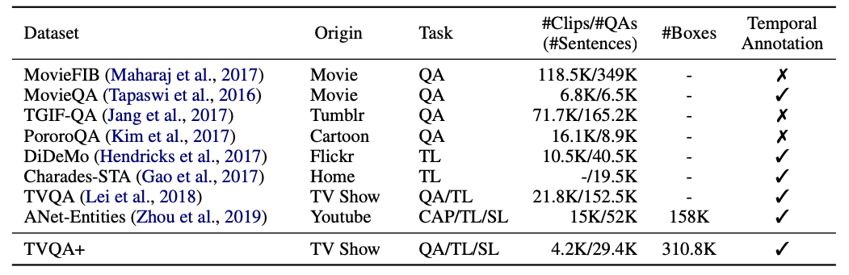
Data Statistics
Comparison of TVQA+ with other video-language datasets. TL=Temporal Localization, SL=Spatial Localization, CAP=Captioning.
ACL 2020
Notes:
We call this newly collected dataset, TVQA+.
It contains 29K QA pairs from 4.2K videos, with 150K images annotated with more than 300K bounding boxes.
TVQA+ is unique as it supports three tasks: question answering, temporal localization, and spatial localization.

Slide 11
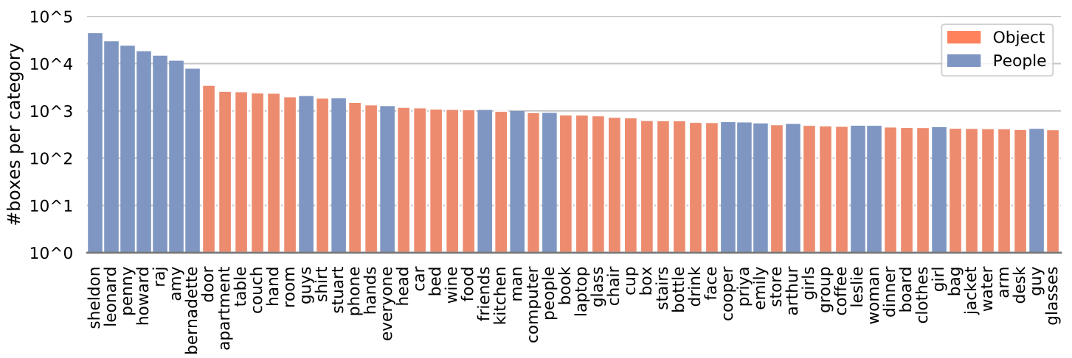
Data Statistics
Box distributions for top 60 categories in TVQA+ train set.
ACL 2020
Notes:
On average, we obtain 2 boxes per image and 10 boxes per question.
The annotated boxes cover 2.5K categories. We show the number of boxes (in log scale) for each of the top 60 categories.
The distribution has a long tail, e.g., the number of boxes for the most frequent category “sheldon” is [CLICK] around 2 orders of magnitude larger than the 60th category “glasses”.

Slide 12
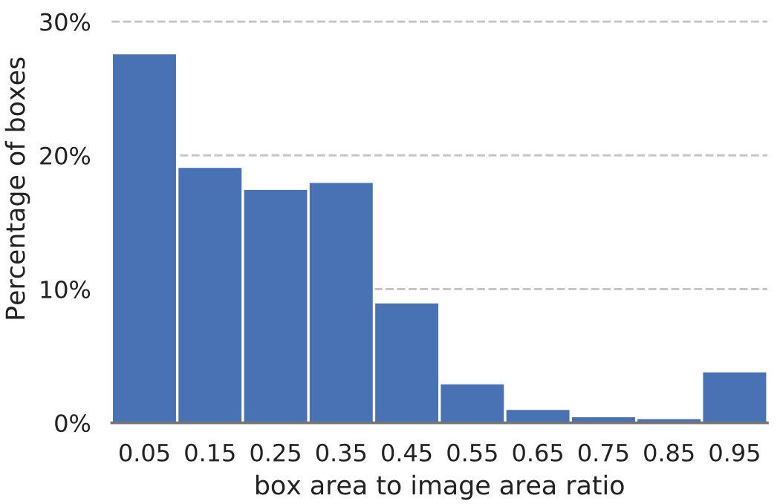
Data Statistics
ACL 2020
Notes:
We also show the distribution of bounding box area over image area ratio.
The majority of boxes are fairly small compared to the image, which makes object grounding challenging.

Slide 13
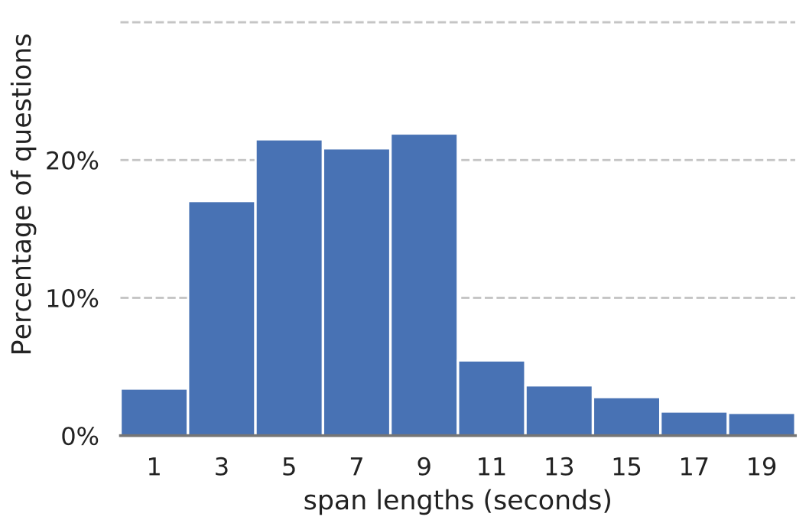
Data Statistics
Average span length is 7.2 seconds, the average video length is 61.5 seconds.
ACL 2020
Notes:
Here we shows the distribution of localized span length. While most spans are less than 10 seconds, the largest spans are up to 20 seconds.
The average span length is 7.2 seconds, which is short compared to the average length of the full video, which 61.5 seconds.

Slide 14
TVQA+ Tasks
00:00
01:02
What is Sheldon holding when he is talking to Howard about sword?
0) A comic book
1) A computer
2) A sword
3) A toy train
4) A drink
Question Answering
Temporal Localization
Object Grounding.
ACL 2020
Notes:
With its diverse annotations, TVQA+ supports three tasks. The first is questions answering, [CLICK ]where we ask a model to select an answer given a video and a question with 5 candidate answers.

Slide 15
TVQA+ Tasks
00:00
01:02
00:02
00:10
What is Sheldon holding when he is talking to Howard about sword?
0) A comic book
1) A computer
2) A sword
3) A toy train
4) A drink
Question Answering
Temporal Localization
Object Grounding.
ACL 2020
Notes:
The 2nd tasks is Tempioral localization, where we require the model to correctly localize the clip that is revelant to a given natural language question.

Slide 16
TVQA+ Tasks
00:00
01:02
00:02
00:10
What is Sheldon holding when he is talking to Howard about sword?
0) A comic book
1) A computer
2) A sword
3) A toy train
4) A drink
Question Answering
Temporal Localization
Object Grounding.
ACL 2020
Notes:
The 3rd task is object grounding, where we aim to correctly localize the objects and people in the questions and the correct answers.

Slide 17
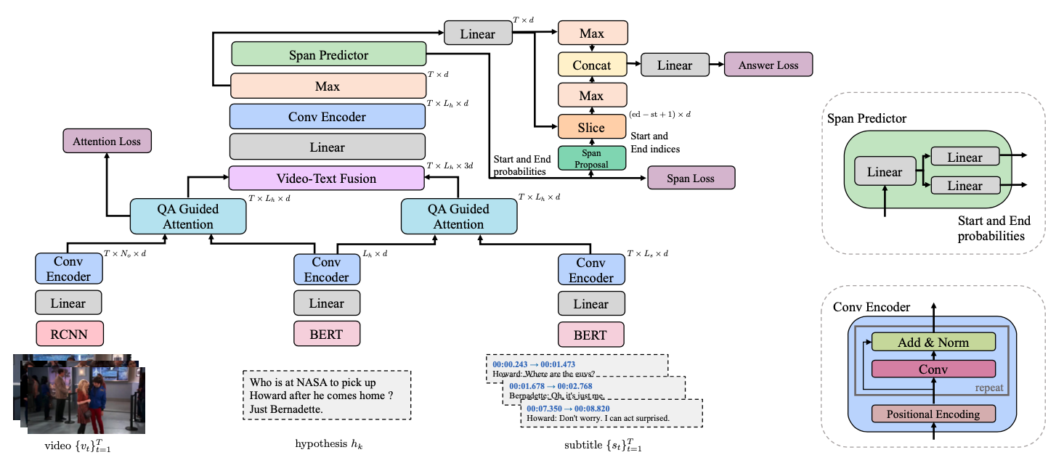
Spatio-Temporal Answerer with Grounded Evidence (STAGE)
Video
Q+A
Subtitle
ACL 2020
Notes:
To jointly perform these 3 tasks, we propose STAGE: spatio-temporal answerer with grounded evidence.
[CLICK] We first describe our input embedding layers.

Slide 18
Spatio-Temporal Answerer with Grounded Evidence (STAGE)
Video
Q+A
Subtitle
Input Embedding Layers
We extract detection feature with Faster R-CNN for video and extract BERT text features
for questions, answers and subtitles, they are then contextualized with a CONV encoder.
ACL 2020
[Ren, et al., NIPS 2015; Devlin et al., NAACL 2019]
Notes:
We extract detection region features with Faster R-CNN for video and extract BERT text features for questions, answers and subtitles, they are then contextualized wth a Conv encoder.
Specifically, …

Slide 19
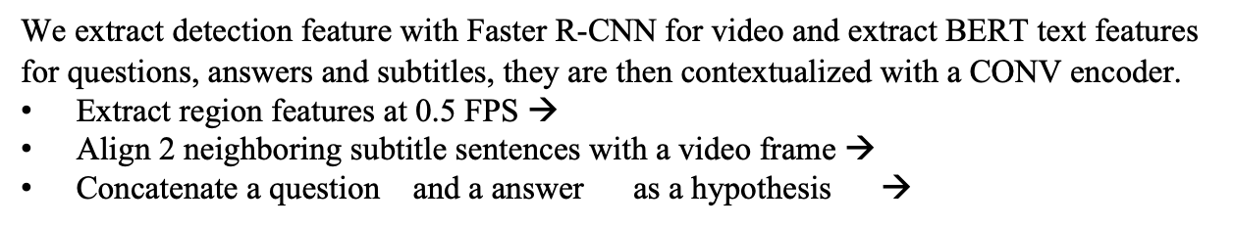
Spatio-Temporal Answerer with Grounded Evidence (STAGE)
Video
Q+A
Subtitle
Input Embedding Layers
We extract detection feature with Faster R-CNN for video and extract BERT text features
for questions, answers and subtitles, they are then contextualized with a CONV encoder.
Extract region features at 0.5 FPS →
Align 2 neighboring subtitle sentences with a video frame →
Concatenate a question and a answer as a hypothesis →
ACL 2020
Notes:
Specifically, we extact detection region features at 0.5 FPS

Slide 20
Spatio-Temporal Answerer with Grounded Evidence (STAGE)
Video
Q+A
Subtitle
Input Embedding Layers
We extract detection feature with Faster R-CNN for video and extract BERT text features
for questions, answers and subtitles, they are then contextualized with a CONV encoder.
Extract region features at 0.5 FPS →
Align 2 neighboring subtitle sentences with a video frame →
Concatenate a question and a answer as a hypothesis →
ACL 2020
Notes:
We align 2 neighboring subtitle sentences with each video frame, and extract contexualized token embeddings.

Slide 21
Spatio-Temporal Answerer with Grounded Evidence (STAGE)
Video
Q+A
Subtitle
Input Embedding Layers
We extract detection feature with Faster R-CNN for video and extract BERT text features
for questions, answers and subtitles, they are then contextualized with a CONV encoder.
Extract region features at 0.5 FPS →
Align 2 neighboring subtitle sentences with a video frame →
Concatenate a question and a answer as a hypothesis →
ACL 2020
Notes:
We concatenate a question and an answer as a hypothesis and extract BERT embeddings, also at token level.

Slide 22
Spatio-Temporal Answerer with Grounded Evidence (STAGE)
QA Guided Attention
We compute the matching scores from QA words to each visual region (each subtitle word).
For frame , the scores from the QA words to each region
ACL 2020
Notes:
Nextly, we compute matching scores from QA words w.r.t. each visual region or each subtitle word.
For example, for frame V_t, the matching scores are computed as the cosine similarity between the visual region embeddings and the QA word embeddings.

Slide 23
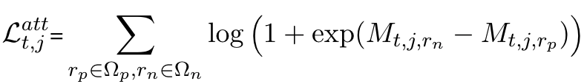
Spatio-Temporal Answerer with Grounded Evidence (STAGE)
QA Guided Attention
We compute the matching scores from QA words to each visual region (each subtitle word).
For frame , the scores from the QA words to each region
We apply LogSumExp loss to encourage the positive word-region pairs to have higher scores
than the negative pairs:
ACL 2020
[Li et al., CVPR 2017]
Notes:
While the matching scores can be learnt with the remote QA supervision, as we have grounding annotations, we also apply LogSumExp, a variant of the max-margin loss to encourage the positive word-region pairs to have higher scores than the negative pairs.
During inference, we directly take the regions with scores higher than a certain threshold as our object grounding prediction.

Slide 24
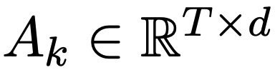
Spatio-Temporal Answerer with Grounded Evidence (STAGE)
Video
Q+A
Subtitle
Aligned Video-Text Fusion
With the matching scores, we compute the attened QA-aware video and subtitle representation
and fuse them at frame-level:
We further encode the fused representation with a linear layer followed by a conv encoder and a
max-pooling layer to obtain the final respresentation
ACL 2020
Notes:
With the matching scores, we compute the attended QA-aware video and subtitle representation and fuse them at frame-level.

Slide 25
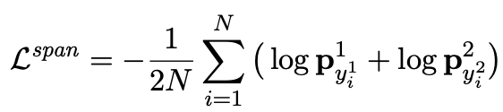
Spatio-Temporal Answerer with Grounded Evidence (STAGE)
Span Loss
Span start and end probabilities
Linear &
Softmax
Span Prediction
Linear
Linear &
Softmax
We produce start probabilities and end probabilities with two linear layers with softmax. We
apply cross-entropy loss to encourage higher probabilities at the ground-truth start and end location.
At inference, we use the pair with the highest joint probability.
ACL 2020
Notes:
For span prediction, we produce start and end probabilities with two linear layers with softmax. We
apply cross-entropy loss to encourage higher probabilities at the ground-truth start and end locations.
At inference, we use the 𝑠𝑡𝑎𝑟𝑡 𝑎𝑛𝑑 𝑒𝑛𝑑 pair with the highest joint probability as our prediction.

Slide 26
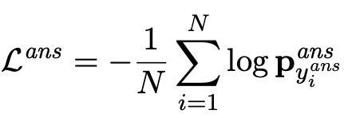
Spatio-Temporal Answerer with Grounded Evidence (STAGE)
global feature
local feature
Answer Prediction
We perform max-pooling at temporal axis for both the final embedding (global feat.) and the predicted span regions (local feat.), these two pooled representations are concatenated and fed into a linear for answer prediction. We use cross-entropy loss for training.
ACL 2020
Notes:
For answer prediction, we perform max-pooling at temporal axis for both the global features $A_{k}$ and the local features from predicted
span $A_{k}[st :ed+1]$, these two pooled representations are concatenated and fed into a linear layer for answer prediction.
The local features are added here as they are believed to contain more question relevant information.
We then use cross-entropy loss for training.

Slide 27
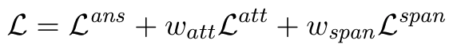
Spatio-Temporal Answerer with Grounded Evidence (STAGE)
Linear &
Softmax
Linear
Linear &
Softmax
Overall Objective
ACL 2020
Notes:
Our overall objective is a weighted combination of the the three objectives, including answering prediction, grounding and span prediction.

Slide 28
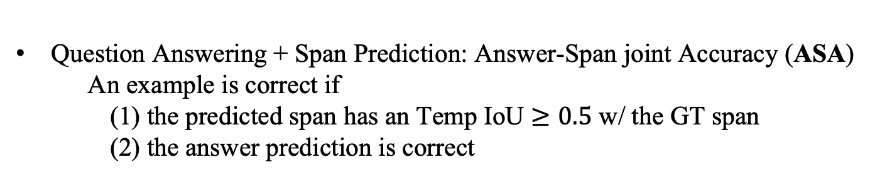
Metrics
Question Answering: Question Answering Accuracy (QA Acc.)
Span Prediction: Temporal mean Intersection-over-Union (Temp. mIoU)
Question Answering + Span Prediction: Answer-Span joint Accuracy (ASA)
An example is correct if
(1) the predicted span has an Temp IoU $≥0.5$ w/ the GT span
(2) the answer prediction is correct
Linear &
Softmax
Linear
Linear &
Softmax
Object Grounding: mean Average Precision (Grd. mAP) at IoU $=0.5$
ACL 2020
Notes:
To measure QA performance, we use classification accuracy (QA Acc.).
[CLICK] We evaluate span prediction using temporal mean Intersection-over-Union following previous work on language-guided video moment retrieval.
[CLICK] Additionally, we propose Answer-Span joint Accuracy (ASA), that jointly evaluates both answer prediction and span prediction.
For this metric, we define a prediction to be correct if the predicted span has an IoU ≥ 0.5 with the GT span, provided that the answer prediction is correct.
[CLICK] Finally, to evaluate object grounding performance, we use mean Average Precision at IoU = 0.5

Slide 29
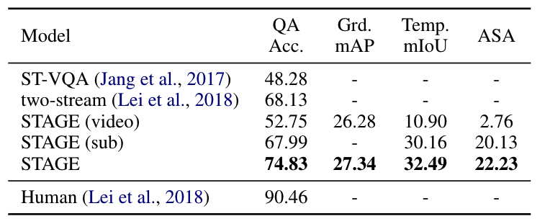
Results
TVQA+ Test Set Results
STAGE has higher QA Acc. than previous approaches and is able to perform 3 tasks.
STAGE with both videos and subtitles has the best performance across all metrics.
Linear &
Softmax
Linear
Linear &
Softmax
TVQA+ test set results.
ACL 2020
Notes:
In this table we compare STAGE with previous methods and also with two STAGE variants that use only video or subtitle as input.
[CLICK] We noticed that STAGE has higher QA Acc. than previous approaches and is able to perform 3 tasks at the same time.
[CLICK] And also, the model that uses both videos and subtitles have higher performance than the single modality models, showing both videos/subtitles are useful for the task.
[CLICK] However, our best model is still far below human performace, leaving large room for future improvement.
(The other models does not perform word-to-region attention, but rather whole question to region attention. It is also not clear how to generate temporal span prediction from a temporal attention scores.)

Slide 30
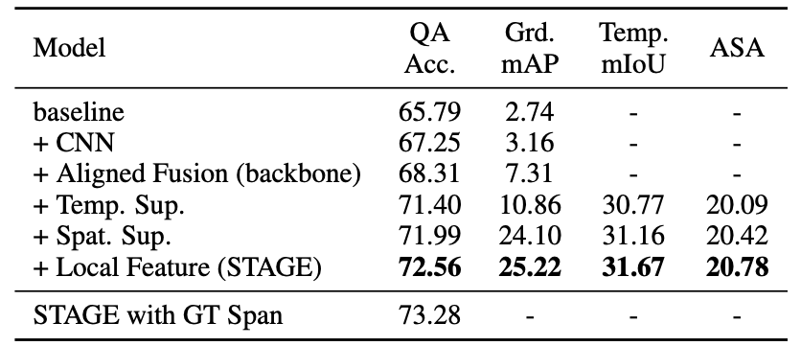
Results
Ablation Study
Adding temporal and spatial supervision is helpful (e.g., QA Acc. 68.31 → 71.99 )
Adding local feature (features inside predicted span) are also helpful. (QA Acc. 71.99 → 72.56)
When using GT span local feature, we see further improvement (QA Acc. 72.56 → 73.28)
Linear &
Softmax
Linear
Linear &
Softmax
Ablation study of STAGE on TVQA+ val set. Each row adds an extra component to the row above it.
ACL 2020
Notes:
In ablation study, we show that Adding Temporal and Spatial supervison is helpful for all the three tasks.
[CLICK]
For example, we obervse 4.6 point improvement in QA Acc. when we add both spatial and temporal supervision.
[CLICK] Adding local features, which are the features inside the predicted span are also useful.
[CLICK] When using ground-truth span, we see further improvement.

Slide 31
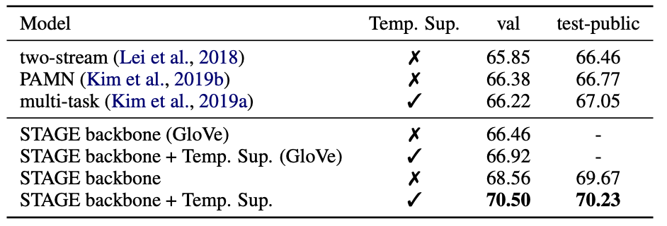
Results
Full TVQA Dataset Experiments
STAGE performs better than the best published results, i.e., 70.23 vs. 67.05 (test-public)
This also holds true when using GloVe feature: 66.92 vs. 66.22 (val)
Linear &
Softmax
Linear
Linear &
Softmax
QA Acc. on the full TVQA dataset.
ACL 2020
Notes:
To show the effectivenss of STAGE, we also conducted experiments on the full TVQA dataset.
[CLICK] we observe that STAGE performs better than the best published results, around 3 point higher on test-public split.
[CLICK] This conclusion also holds true when we use GloVe feature for STAGE.

Slide 32
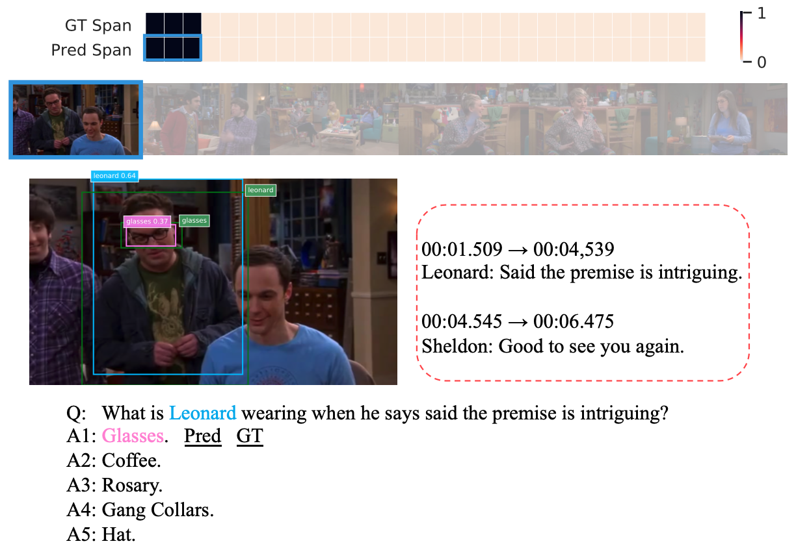
Prediction Examples from STAGE
Span Prediction
Object Grounding
Linear &
Softmax
Linear
Linear &
Softmax
Question Answering
A correct prediction example from STAGE.
ACL 2020
Notes:
Here we show a correct prediction example from STAGE, notice how it is able to simultaneously localize temporal span [CLICK], ground object in the frames [CLICK], and also answer the question [CLICK], .
For example, STAGE correctly localized the moment that Leonard said the premise is intriguing, and also spatially localized Leonard and the glasses he is wearing in the frame.
So the model could correctly answer the question with the answer that Leonard is wearing glasses.

Slide 33
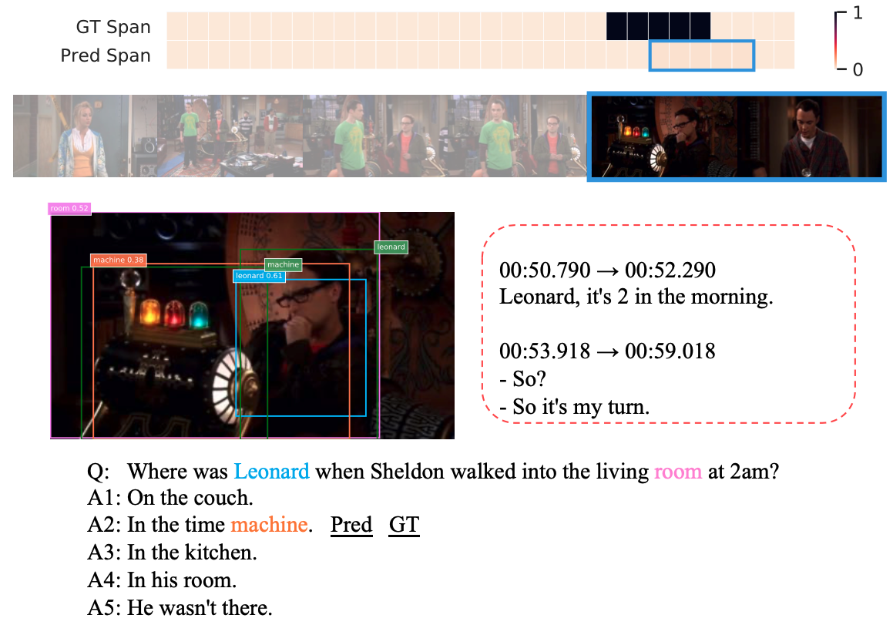
Prediction Examples from STAGE
Span Prediction
Object Grounding
Linear &
Softmax
Linear
Linear &
Softmax
Question Answering
A correct prediction example from STAGE.
ACL 2020
Notes:
Here we show another correct prediction example from STAGE,
While the model did not localize the temporal span perfectly, it correctlt answers the question that Leonard is in the time machine when Sheldon walked into the living room at 2.

Slide 34
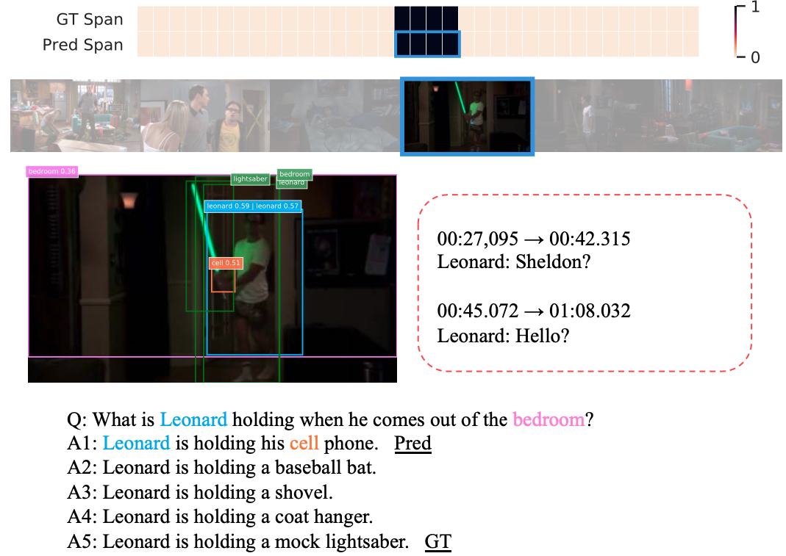
Prediction Examples from STAGE
Span Prediction
Object Grounding
Linear &
Softmax
Linear
Linear &
Softmax
Question Answering
An incorrect prediction example from STAGE.
ACL 2020
Notes:
We also show a failure case, we see that STAGE is still able to correctly localize the span and localize some objects and people.
It fails probably due to the fact that the correct answer object mock lightsaber is too rare to see in the data, which makes it hard for the model to localize.

Slide 35


Thanks!
Linear &
Softmax
Linear
http://tvqa.cs.unc.edu/
Linear &
Softmax
https://github.com/jayleicn/TVQAplus
ACL 2020
Notes:
Our dataset and code are publicly available at the following links. Thanks for your attention!

